Slide 1
ONE SIZE DOES NOT FIT ALL
IMPROVING THE PATIENT CARE EXPERIENCE FOR CHILDREN WITH AUTISM SPECTRUM DISORDER

Slide 2
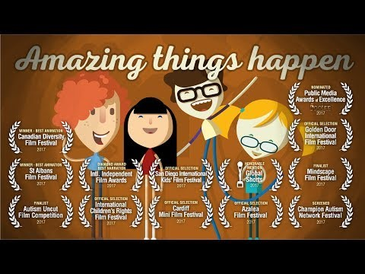
Notes:
I’d like to show this video to help set the mood for the presentation. This video was made by Alex Amelines, writer and director based in England. He has made this video free and available to educators across the world in many different languages.
It is intended for younger audiences but I think it will help set the tone for our discussion.

Slide 3
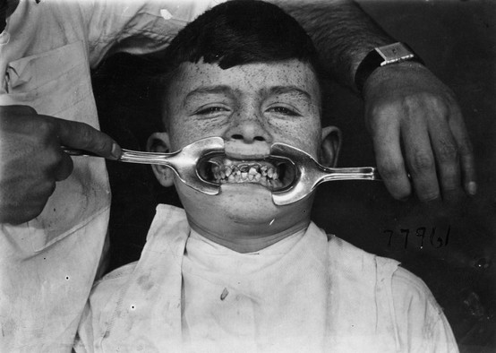
Dental Procedures: they weren’t going great!
Notes:
The children we see for dental procedures under general anesthesia tend to be patients that did not tolerate regular dental visits.
Many had a very difficult time waking up in PACU. Then renovations came along and really exacerbated the situation.
Our PACU unit got split. Dental procedures now ran out of our satellite OR that had a two stretcher PACU attached to it.
We had limited staff, limited resources and a long trip back down to Day Ward to drop our patients off.
We were transporting patients through public spaces, screaming, crying, attempting to run away from us.
Vast majority of our dental procedure patients were had a primary diagnosis of Autism Spectrum Disorder.
We used our dental patients and Autism Spectrum Disorder as our starting point to see what could be done to improve the patient care experience, to help our staff be safer.

Slide 4
DSM-5 Diagnostic Criteria
Persistent deficits in social communication and social interaction across multiple contexts.
Notes:
I don’t want to spend a lot of time discussing what ASD is. It is a complex neurodevelopmental disorder and as the name implies it is a spectrum. I want to give you an idea of how broad of a spectrum it is. One patient with ASD is not like another but there are certain hallmarks of the disorder.
The DSM-5 criteria to diagnose ASD as follows:
Persistent deficits in social communication and social interaction across multiple contexts, as manifested by the following, currently or by history (examples are illustrative, not exhaustive; see text):
Deficits in social-emotional reciprocity, ranging, for example, from abnormal social approach and failure of normal back-and-forth conversation; to reduced sharing of interests, emotions, or affect; to failure to initiate or respond to social interactions.
Deficits in nonverbal communicative behaviors used for social interaction, ranging, for example, from poorly integrated verbal and nonverbal communication; to abnormalities in eye contact and body language or deficits in understanding and use of gestures; to a total lack of facial expressions and nonverbal communication.
Deficits in developing, maintaining, and understanding relationships, ranging, for example, from difficulties adjusting behavior to suit various social contexts; to difficulties in sharing imaginative play or in making friends; to absence of interest in peers.

Slide 5
DSM-5 Diagnostic Criteria
Restricted, repetitive patterns of behavior, interest, or activities.
Notes:
Restricted, repetitive patterns of behavior, interests, or activities, as manifested by at least two of the following, currently or by history (examples are illustrative, not exhaustive; see text):
Stereotyped or repetitive motor movements, use of objects, or speech (e.g., simple motor stereotypies, lining up toys or flipping objects, echolalia, idiosyncratic phrases).
Insistence on sameness, inflexible adherence to routines, or ritualized patterns of verbal or nonverbal behavior (e.g., extreme distress at small changes, difficulties with transitions, rigid thinking patterns, greeting rituals, need to take same route or eat same food every day).
Highly restricted, fixated interests that are abnormal in intensity or focus (e.g., strong attachment to or preoccupation with unusual objects, excessively circumscribed or perseverative interests).
Hyper- or hyporeactivity to sensory input or unusual interest in sensory aspects of the environment (e.g., apparent indifference to pain/temperature, adverse response to specific sounds or textures, excessive smelling or touching of objects, visual fascination with lights or movement).

Slide 6
DSM-5 Diagnostic Criteria
Symptoms must be present in the early developmental period.
Notes:
Symptoms must be present in the early developmental period (but may not become fully manifest until social demands exceed limited capacities, or may be masked by learned strategies in later life).

Slide 7
DSM-5 Diagnostic Criteria
Symptoms cause clinically significant impairment in social, occupational, or other important areas of current functioning.
Notes:
Symptoms cause clinically significant impairment in social, occupational, or other important areas of current functioning.

Slide 8
DSM-5 Diagnostic Criteria
These disturbances are not better explained by intellectual disability
Notes:
These disturbances are not better explained by intellectual disability (intellectual developmental disorder) or global developmental delay. Intellectual disability and autism spectrum disorder frequently co-occur; to make comorbid diagnoses of autism spectrum disorder and intellectual disability, social communication should be below that expected for general developmental level.
pragmatic) communication disorder.

Slide 9
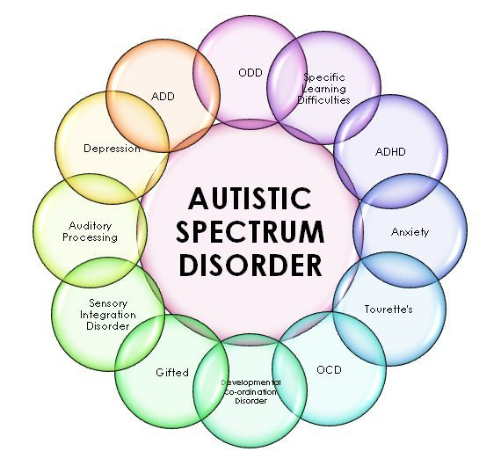
Notes:
Associated with a known medical or genetic condition or environmental factor: such as fragile X syndrome or tuberous sclerosis
Associated with another neurodevelopmental, mental, or behavioral disorder: such as ADHD, anxiety, depression, Tourette’s

Slide 10
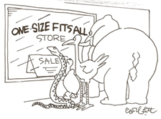
The Surgical Journey
Notes:
Also inflexible,
Strict NPO times
Arrive 2 hours early
Wait in a noisy waiting room
We have a child that has difficulty dealing with change and an inflexible system that lacks adaptability. As a program we knew that we will not change our patients but we knew we wanted to make things better. Many of these patients were returning for procedures. We became aware of a key concept: negative experiences with the medical system lead, typically lead to more negative experiences down the line.

Slide 11
Cognitive Cycle
Experience
Thoughts
Feelings
Behavior
Notes:
There is a strong relationship between previous distressing medical experiences, including pain, embarrassment, and fear and subsequent negative experiences and it can snowball!
Looking at the cognitive cycle, we can see how a negative hospital experience can drive negative thoughts. Thoughts drive feelings and feelings drive behavior.
The cycle can be broken at any stage.

Slide 12
Let’s be more flexible
A parent pre-operative survey
Notes:
We worked with a psychologist at the Glenrose (Shawn Reynolds) on developing a tool to help us better understand the patient, the family and the patients needs. We also offered education about ASD to the Day Ward staff.
The form was originally 2 pages long and quiet extensive. We asked about items such as anxiety triggers, coping strategies, ability communicate and how pain was communicated. We would follow-up with a phone call to make a plan the night before the patient was due to arrive on Day Ward.
Then we had the brilliant idea that there are many patients out there, that are not necessary identified that could also benefit sharing this information with us. We also felt that since not all patients with ASD have difficulties in the hospital (only about 50-80% do, depending on the study) that it would be great if patients could self-identify. So we tried to imbed the form in the pre-operative database.
The backlash was severe from the surgeon’s offices (even though we did consult the head of pediatric anesthesia and the head of pediatric surgery). Parents had a hard time understanding why we are asking about anxiety and triggers and the surgeon’s offices felt they did not have time to take the parents through the form.
So as of now the form is much shorter and is only given to patients at the office if someone things it may be a good idea for the staff at the hospital to be given a heads up that the patient may not cope well with their visit.
Having conducted many pre-op phone calls myself, I also found that parental perception could be a limitation.
The form is shared throughout our program, so that we are all on the same page.
Special accommodations based on the survey are then made. They range from meeting the patient outside of Day Ward in plain clothing so they don’t get scared. Involving Child Life. Arranging for a quiet, private space. Allowing the family to come-in just prior to the procedure.
From the parent side of things, parents will talk about dignity. As you can imagine they do not want to be a public spectacle when their child is having a hard time. Privacy can be very important to the parents and to some patients as well.

Slide 13
Let’s be more flexible
Parents in the OR and PACU
Notes:
Parental presence can be a great resource for the patients and nurses. As communication can be difficult is can be hard to tease out in the post operative time period whether the patient is in pain, is anxious or even delirious. Recognizing that parents/caregivers are experts in the care of their child and that they know what works with their children, parental presence can help shine a light on the situation and de-escalate.
In times of great stress parents can also break down. Children look to them for strength. It is important for the parents to know that it is ok for them not to be there, or for someone else to step in for them.
But of course our space is limited, so we strongly discourage multiple family members being present. Unfortunately sometimes the supporter also needs support.
OUR PACU unit was divided and we had a satellite unit within the adult OR. Many dental patients were processed through our satellite unit and the journey back to level one was often horrible. Patients were running away from us on the trip down, holding elevator doors open and so on. We started to bring parents in when the patient was waking up and had many positive experiences in the patient remaining calm.

Slide 14
Let’s communicate better
The visual journey

Slide 15
Anesthesia solution
Dexmedetomidine
Notes:
Pre-op sedation, intra-op use

Slide 16
Child Life
Pre-operatively
Intraoperatively
Coping clinic

Slide 17
Distractions
Snoozelen
I-pads

Slide 18
PEAD scale
 | Not at all | Just a little | Quite a bit | Very Much | Extremely
Makes eye contact with caregiver | 4 | 3 | 2 | 1 | 0
Actions are purposeful | 4 | 3 | 2 | 1 | 0
Aware of surroundings | 4 | 3 | 2 | 1 | 0
Restless | 0 | 1 | 2 | 3 | 4
Inconsolable | 0 | 1 | 2 | 3 | 4

Slide 19
References
Experiences of Dental Care and Dental Anxiety in Adults with Autism Spectrum Disorder (2014) by My Blomqvist, Goran Dahllof and Susanne Bejerot

